Slide 1

eExpenses Launch Event for Administrators
Oct 2021

Slide 2
Agenda
Background
Preparing for launch
Approve/Reject a Claim – demo

Slide 3
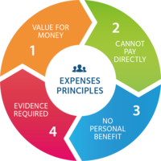
Expenses Principles and guidance
Value for money is achieved.
Expenses should only be used when it is not possible and/or practical for the University to pay for the good or service directly.
Costs incurred are for business purposes only, and the individual does not receive a personal benefit.
Only actual and evidenced costs are reclaimed.
Expenses | Finance Division (ox.ac.uk)
Claimants' Expenses Guidance | Finance Division (ox.ac.uk)
Departmental Expenses Guidance | Finance Division (ox.ac.uk)

Slide 4

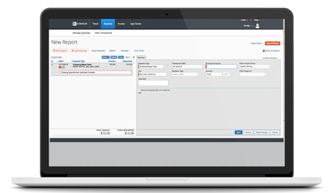
eExpenses system
Benefits include:
  Simpler process and increased transparency for expenses claims.
  Quicker remuneration of expenses claims.
  Better cost controls for budget-holders and administrators.
  Ability to track claims
  Fewer queries
  Better data

Slide 5
Launch timetable
18 October – available to Social Sciences departments
18 Oct to 1 Nov – Social Sciences go live
5 Nov – Project Board confirm go live to continue
15 Nov – available to the rest of the University
15 Nov to Easter 2022 – rest of University go live
Easter 2022 – old expenses form retired

Slide 6
Preparing for the launch
Preparing your claimants
Preparing yourselves and your teams
Review of admin roles

Slide 7
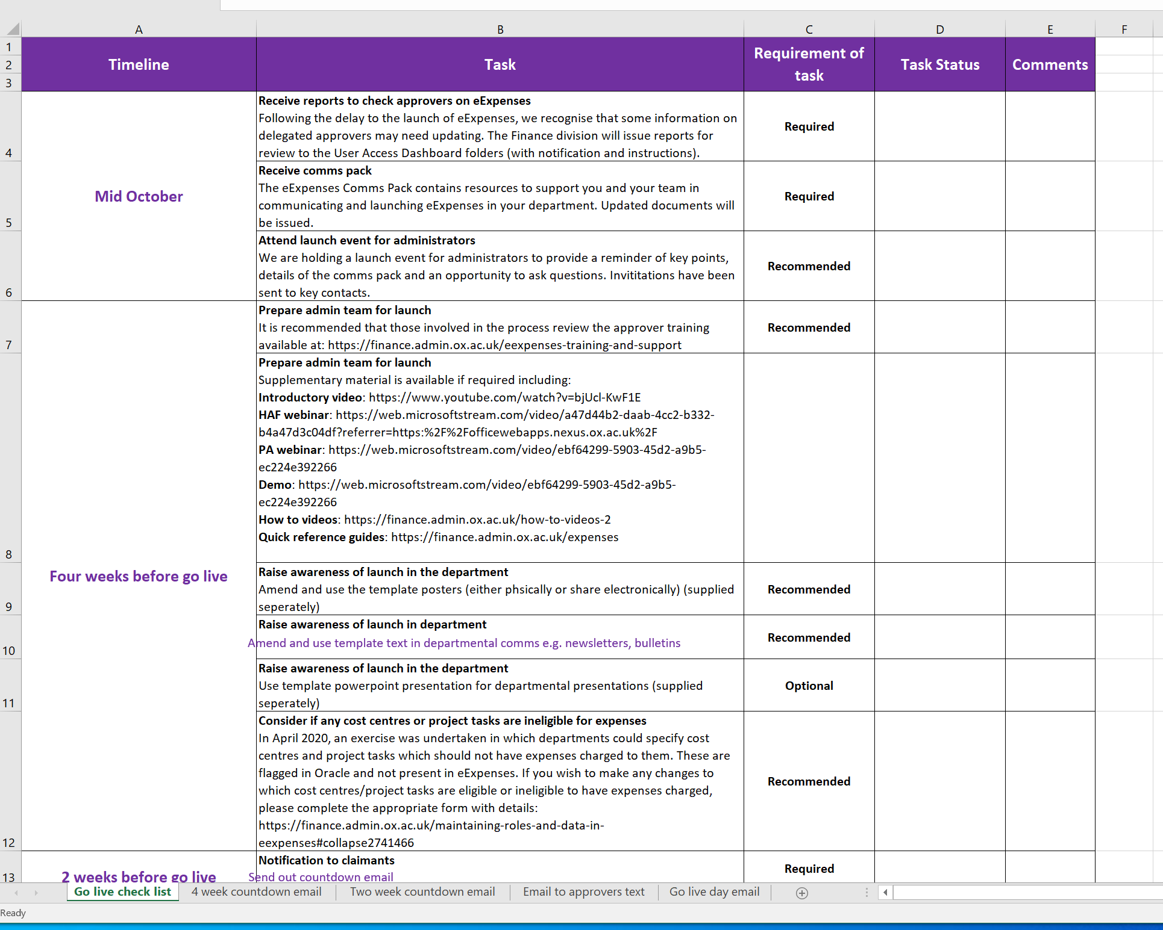
Go live checklist

Slide 8
Preparing your claimants
Four weeks before – think about raising awareness
Two weeks before – issue countdown email
Go live – issue go live email
Launch sessions – please share the invitations and attend

Slide 9
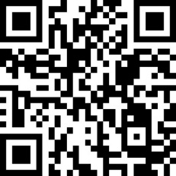
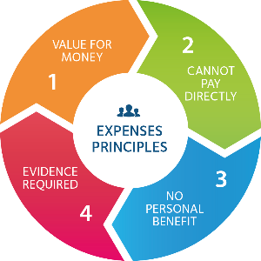

Claiming expenses?
From date use
SAP® Concur® eExpenses
for most expense claims
More information:
Department contact:
[Insert local contact details]
https://finance.admin.ox.ac.uk/expenses

Slide 10
Preparing your claimants
Four weeks before – think about raising awareness
Two weeks before – issue countdown email
Go live – issue go live email
Launch sessions – please share the invitations and attend
Think about coding
  Claimants can search for codes using either the code or based on the first word of the GL cost centre name or project short name
  TIP: Need to select whether you are searching by code or words

Slide 11
Preparing yourselves and your teams
Training: https://finance.admin.ox.ac.uk/eexpenses-training-and-support
How tos: https://finance.admin.ox.ac.uk/how-to-videos-2
QRGs: https://finance.admin.ox.ac.uk/expense
Demo: https://web.microsoftstream.com/video/ebf64299-5903-45d2-a9b5-ec224e392266
HAF webinar: https://web.microsoftstream.com/video/a47d44b2-daab-4cc2-b332-b4a47d3c04df?referrer=https:%2F%2Fofficewebapps.nexus.ox.ac.uk%2F
PA webinar: https://web.microsoftstream.com/video/ebf64299-5903-45d2-a9b5-ec224e392266
Introductory video: https://www.youtube.com/watch?v=bjUcl-KwF1E

Slide 12
Review of admin roles
Managing roles in eExpenses
Maintaining roles and data in eExpenses | Finance Division (ox.ac.uk)
Responsibilities of approvers:
How to review and approve expenses claims | Finance Division (ox.ac.uk)

Slide 13
Points to Consider
Check each individual line
  For valid receipts
  Appropriateness
Has a valid justification been included in the comments?
Are any attendees appropriate to a Business Entertainment claim?
Is any mileage claimed reasonable?
Have appropriate documents for a mileage claim been seen in the Department?

Slide 14
Approve/Reject a Claim Demo

