Slide 1
Oracle Financials Upgrade iProcurement User Briefing
January & February 2022
Notes:
KG

Slide 2
Welcome
This presentation is to let you know about the Oracle Financials upgrade:
Why we are upgrading
What changes you will see
When the changes take place
How to prepare for the upgrade
Notes:
KG

Slide 3
Agenda
Project purpose
Summary of what’s changing
Timetable
What you should do to prepare
Actions at go-live
Further information and support
System demonstration
Q&A
Notes:
KG

Slide 4
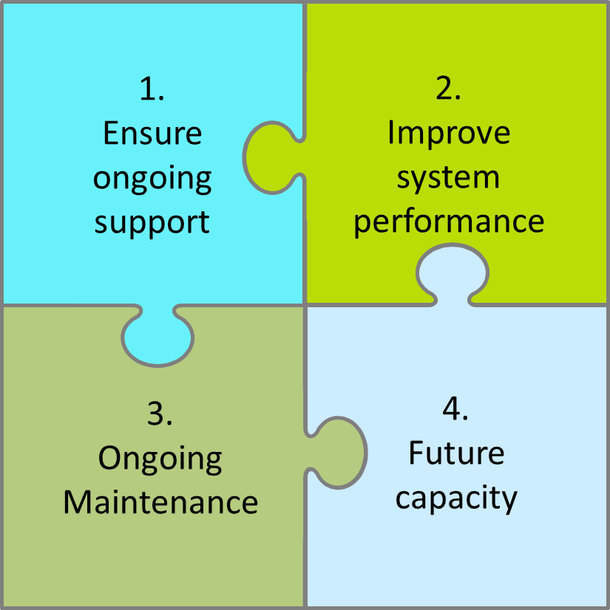
Project purpose
Upgrade to the University’s Oracle Financials system.
Notes:
KG
Support – Oracle support for the current version expires at the end of 2021. We have extended the support agreement but must upgrade to ensure ongoing support.
Performance & stability – We aim to mitigate system performance issues.
Scalability – We need to increase our capacity to support expected growth in user numbers.
Maintenance - We can reduce the amount of system downtime needed for ongoing maintenance.

Slide 5
What’s changing
An updated, more modern ‘look and feel’ for all users.
Changes to Home page including search functionality.
A few changes to specific system modules including i-Procurement.
Notes:
KG

Slide 6
Timetable at a glance
Run-up to upgrade
Departmental preparation
System Upgrade
Upgrade live/
post go-live support
16/02
System down
21/02
System back
22/02
Splash BI back
Notes:
KG

Slide 7
Preparation
Plan ahead so not inconvenienced by system going down – note the deadlines provided to help you with this.
It is advisable to complete all approvals where possible.
Notes:
KG

Slide 8
Preparation: 1-11 February
Month | Date | Deadline | Action
February | 7th | 17:00 | New supplier requests & supplier amendments to be submitted and approved by Departments.
 | 10th | 17:00 | Complete goods receipting.
 | 11th | 16:00 | Complete raising and approval of majority of requisitions.
 | 11th | 17:00 | Ensure you have Edge browser installed and have rebooted machine to enable pop-ups (we will provide further instructions on this).
 | 11th |  | Final pay run
Notes:
LB/AO
When is the last day for a Chap payment to take place ? The last day for CHAPS would be Wednesday 16th Feb.
When the payment run is completed on the 11th how far in advance will the payment be pulled forward until ? The Payment run on 11th will be paying anything due up to and including 1st March.
When will be the first day a same day payment can be actioned after the shut down? As we aren’t sure exactly when the system will become live on Monday 21st – we will do the first CHAPS run on Tuesday 22nd.
When will be the next available payment run , will this be 25th February? Yes, 25th Feb will be the next payment run.
Sapconcur when is the first upload from sap concur into oracle due to take place after the shut down ? The first upload should be 22nd Feb – however SAP will remain open for use during the shut-down and users should not be affected.
Will the deadline for Barclay cards remain unchanged?" the deadline will remain the same, 22nd March.

Slide 9
Preparation: 14-16 February
Month | Date | Deadline | Action
February | 14th |  | Limited requisitions only.
 | 16th |  | Emergency requisitions only.
 | 16th | 13:30 | All requisitions to be approved (we strongly recommend you do not rely on the 4pm PO generation process). Issue purchase orders not automatically sent.
 | 16th | 17:00 | System unavailable
Notes:
LB/AO
System unavailable – note this means all unfulfilled report requests will be cancelled

Slide 10
Actions at go-live
Month | Date | Deadline | Action
February | 21st |  | System re-launched. Please wait for notification that the system can be accessed. Set-up your home page favourites
January | 22nd |  | SplashBI relaunch Please wait for notification that Splash BI can be accessed.
Notes:
LB/AO
Note the system may be a little slower on the first day due to increase in traffic

Slide 11
Further information
Our project intranet page provides information including:
A summary of what is changing
Preparations you should make
FAQs
https://finance.web.ox.ac.uk/oracle-financials-r12.2-upgrade-project
A recording of the system demonstration will be made available to you shortly.
On the Finance intranet pages you will find:
Updated How-To guides (plus a reference guide to changes where you will find the information regarding the changes).
Quick Reference Guides explaining the screen interface changes.
FSSC Service Desk will continue to be available for support.
Notes:
LB/AO

Slide 12
System demonstration https://youtu.be/rptGHb9aNuo
Notes:
KG

