Slide 1
Tax Update – Year end Road show 2023
Sally Mckinlay – Head of Tax
Notes:
Always do an update
Tax issues happening behind the scenes
Tax tops - from any queries we get through the VAT enquiries

Slide 2
Tax Update – Year end road show 2023
Agenda
Tax Strategy 2023
HMRC’s changing approach
VAT adjustments
Research – business versus non-business update
Overseas activities
Opportunities – zero rated goods and advertising

Slide 3
Tax Update – Year end road show 2023
The Tax Strategy has four core objectives:
(1) To comply with mandatory tax, compliance and reporting requirements;
(2) To manage the tax risks and opportunities arising from routine operations;
(3) To support furtherance of the University’s charitable objectives.
(4) To communicate and coordinate with HMRC, where appropriate
Notes:
Now in SAO more scrutiny from HMRC
Exceed £200m threshold which means we have a legal obligation to publish in a certain format.
Writing to HMRC – only we can do that, they will always come back to us, even if funder recommends you write to HMRC, check because we may have already or we can point youin the right direction = guidance
Please come to us with queries we would normally expect to reply within 2/3 working days.
OUFAL is planning – which is allowed

Slide 4
Tax Update – Year end road show 2023
HMRC’s changing approach
HMRC has recruited a significant amount of new officers to work on tax compliance
The Education Sector VAT team has doubled during 22/23
HMRC have created a CT hub – pooled resource
Employment taxes pooled into a cross-sector public sector team
Notes:
Resourcing up
More officers
More targeted approach
IR35 – use the CEST

Slide 5
Tax Update – Year end road show 2023
VAT adjustments
HMRC are scrutinising disclosures
Real time adjustments in quarter
VAT adjustments form – VAT is about use
https://finance.admin.ox.ac.uk/vat
For zero rating – its about use
For VAT recovery - its about use
Notes:
IT can take months to agree an error corrections – please do it real time
Quarter ends 31 Jan 30th April, 31st July and 30th October
VAT is all about use,
ZR rating – medical relief
Recovery - tax

Slide 6
Tax Update – Year end road show 2023
Research – business v non-business update
Publicly funded research(PRF) is non-business even if the sponsor gets some IP, so no VAT recovery
Commercial research is business the sponsor gets something in return, VAT recovery allowed
Some PFR can be a business activity if it’s got commercial potential – VAT recovery
Notes:
Information sheet 2008

Slide 7
Tax Update – Year end road show 2023
Overseas activities – international payrolls
The University has continued to expand its network of overseas shadow payrolls and registrations to support departments with staff working outside the UK under the International Working Arrangements policy.
The policy has a 90-day threshold as a rule of thumb, but departments are asked to be mindful of overseas joint appointments and fractional contracts as these are more likely to create a risk for the department.
Recent additions to the network are shadow payrolls in Spain and Sweden. Future payroll locations include the USA.
Departments should notify the International Working Team of potential overseas cases as early as possible so that advice on the cost and risk implications can be given before an appointment is made or the individual travels overseas.
Please also notify the Team as soon as any changes to existing overseas arrangements are known – such as resignations and changes to working hours, as they may affect our overseas reporting.
Notes:
Israel – really difficult to operate in
Some countries require a legal entity to be set up
Work closely with OUP

Slide 8
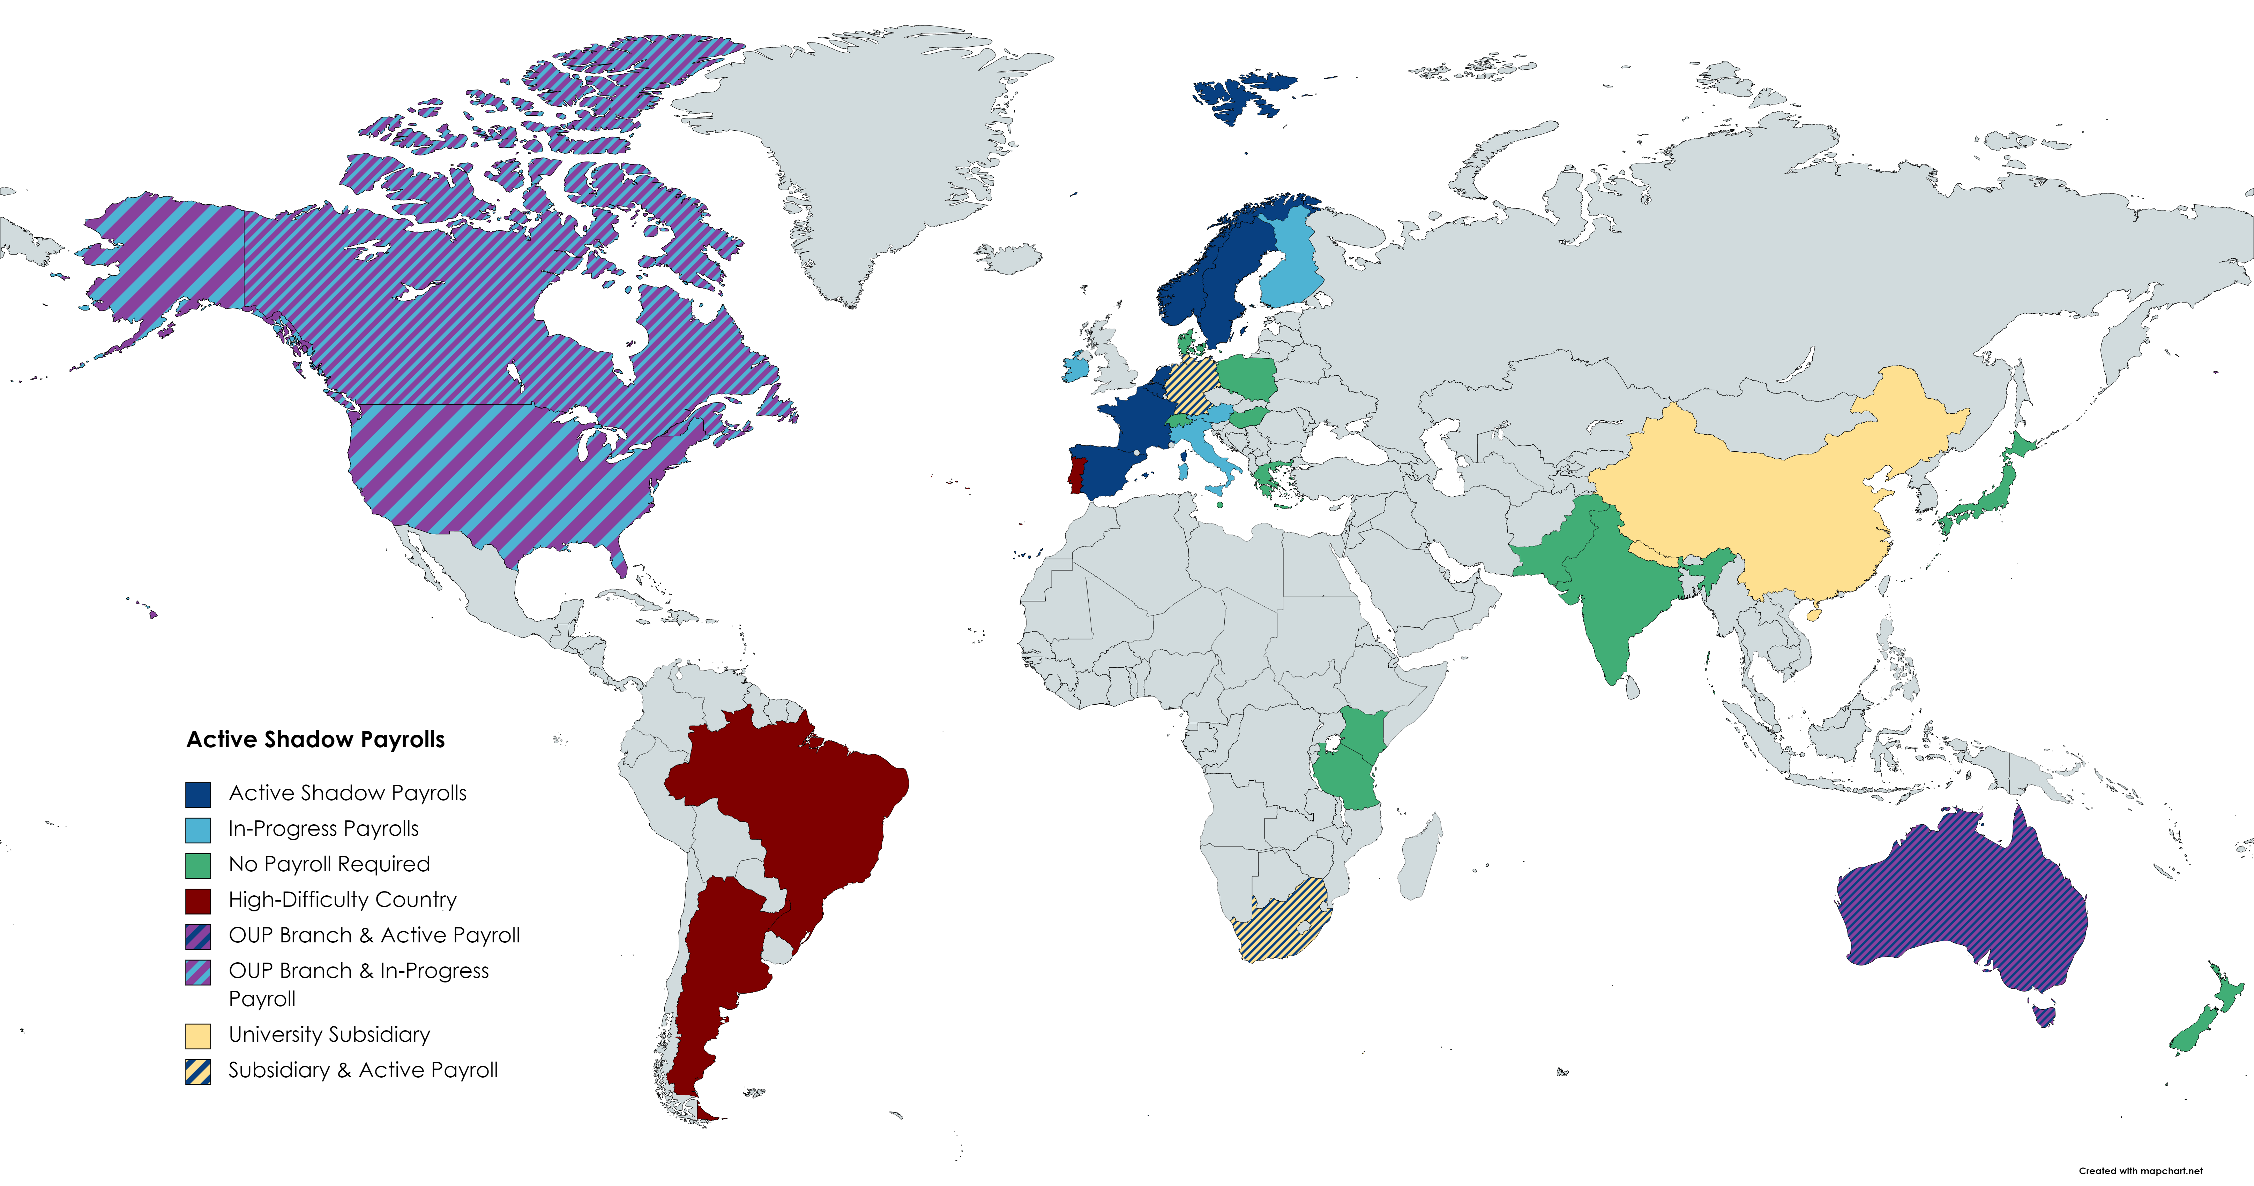
Overseas Presence (Overseas Working)

Slide 9
Tax Update – Year end road show 2023
Overseas activities – contractual tax tips
Buying in overseas services – reverse charge 20% cost
Overseas donations – nothing in return
Customer overseas- beware of withholding tax and VAT
Contractual terms – making sure there is a grossing up clause
Gift agreements – VAT exclusive clauses
Notes:
Under a gross-up clause, a payor must pay an additional amount to a payee to ensure that the payee receives and retains the same amount that it would have received had no tax been withheld from, or otherwise due as a result of, the payment.
Eg 1000 but 20% wht
Careful with PO

Slide 10
Tax Update – Year end road show 2023
Opportunities:
Research project – output is shipping goods outside the EU
Charity advertising – google and LinkedIn

Slide 11
Tax Update – Year end road show 2023
Questions?

