Slide 1
Data: budget 2021/22 excl NHS recharges,unless specified
1

Slide 2
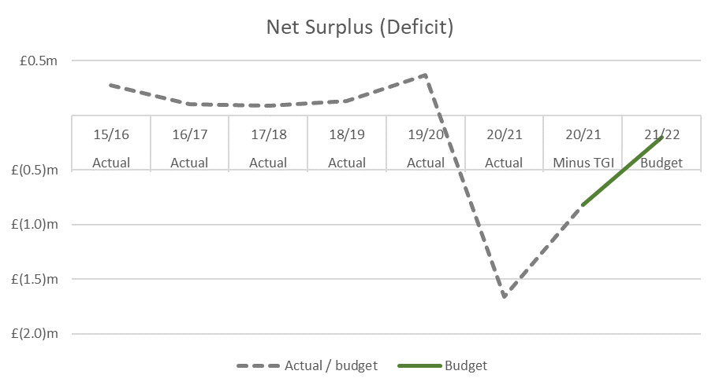
Deficit from TGI, Covid and Funding constraints

Slide 3
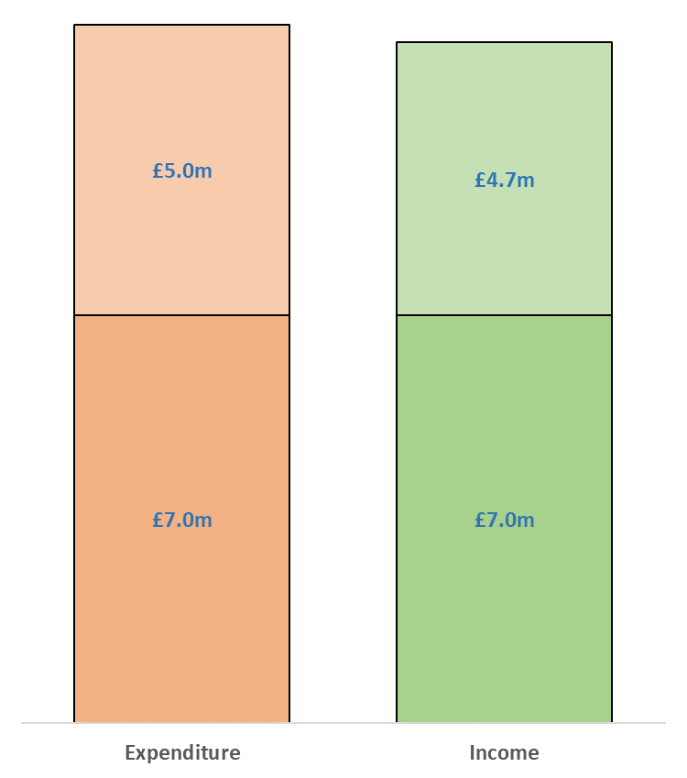
NDWRH budgeting 2% deficit
Everything else
Externally Funded Research (Direct)
Notes:
What does it cost us? Where do we get our income from?

Slide 4
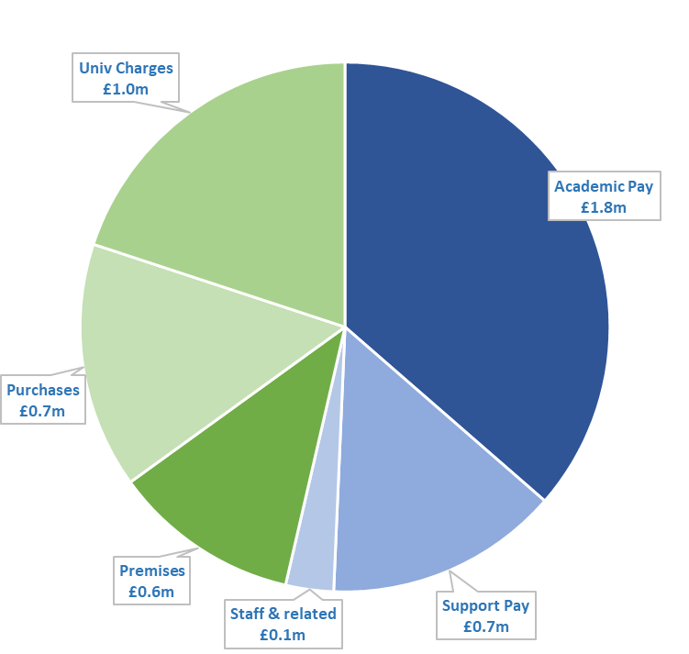
It cost £5m to run the Department last year
Notes:
Pay & purchases – if you can get it funded on a grant then the departments costs reduce – real pressure here
Premises – lower than other departments
Univ charges – eg Divisional teaching, Research support, Libraries, Finance, HR, IT

Slide 5
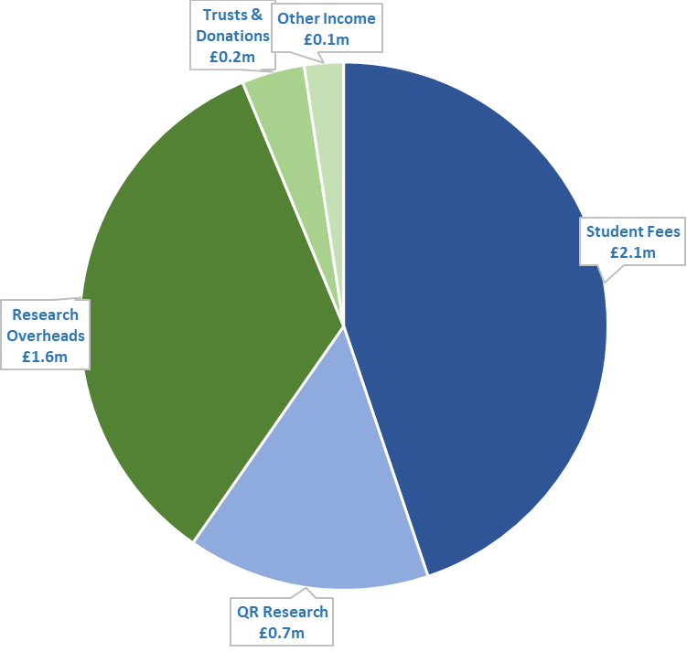
Funding is largely teaching and research
Distributed via JRAM
Notes:
Blue = JRAM, works on a kill what you eat model – no “per-PI” funding as such

Slide 6
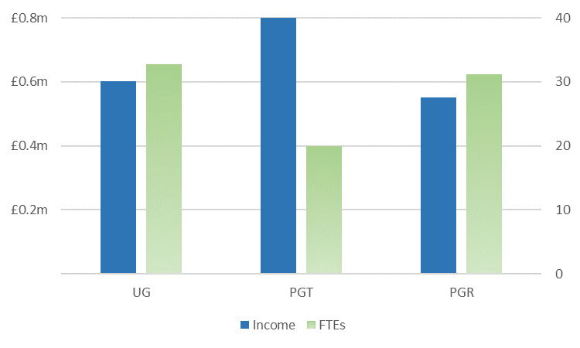
Student Income is an important funding source (21/22)
Notes:
UG underpinning
PGT course very important
PGRs on SNP radar

Slide 7
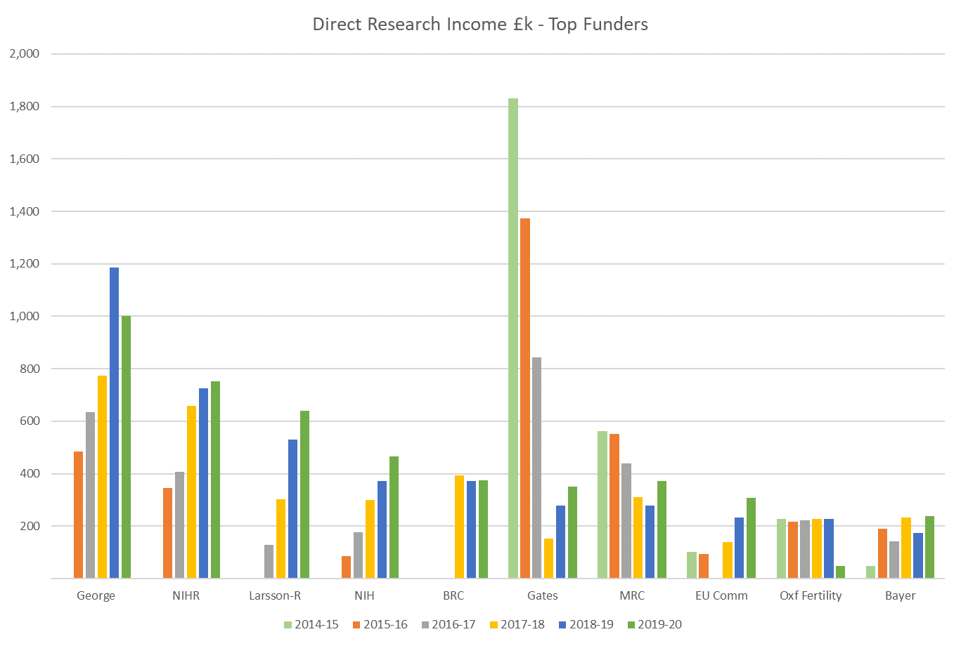
Research: Breadth of Funding Sources
Notes:
Top ten is 80% of direct research income in 18/19
Breadth important both for sustainability: for department & PIs

Slide 8
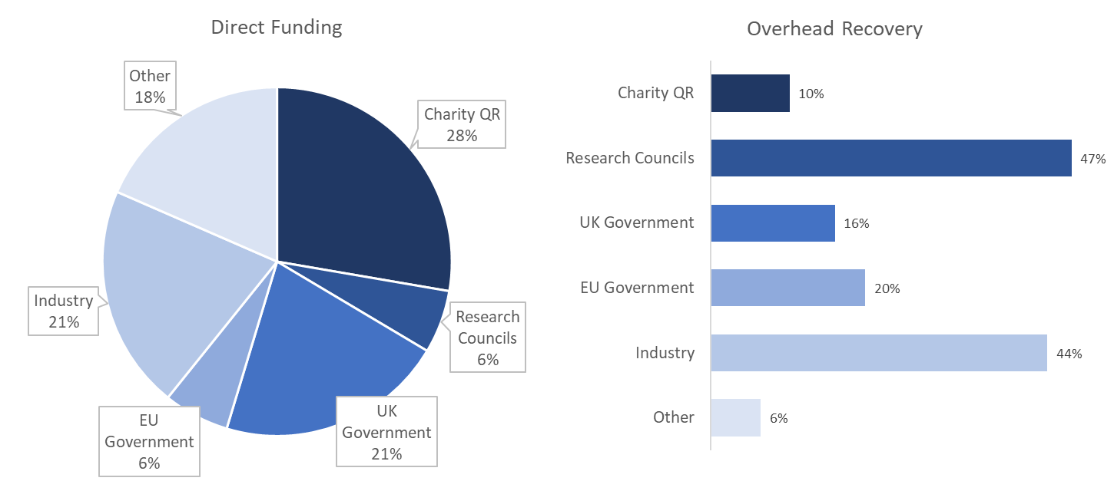
Research funding contribution varies (2019/20 excl TGI)
Notes:
Overall 26% in 18/19
Industry recovers more than the full costs (FEC); RCUK 80%; everyone else much less

Slide 9
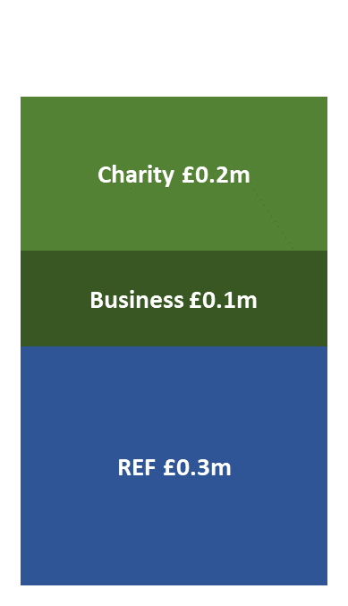
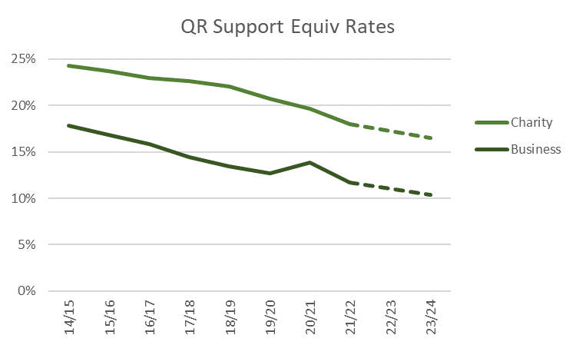
Quality Related (QR) Research Funding
8 Academics submitted in 2013 REF Exercise
Notes:
Risks on both sides

Slide 10
Financial Incentives and Reserves
Finance White Paper to improve accountability and incentives
University Financial Position has been deteriorating
Reserves come from surpluses, which are partly used for investment & subsidy
Financial Incentives to be stronger and more transparent
Implications
Divisional finances with higher profile
Surplus for continued sustainability & control
PI Fund Balances are respected, but spend needs to be planned & transparent

